Slide 1
Research technology in Arts, Humanities and Social Sciences
Fraser Muir
College CIO
University of Edinburgh

Slide 2

About the College
One of 3 academic Colleges in the University of Edinburgh
12 Schools, 23650 students and 3600 staff
Approximately 20% of income from research
Schools vary hugely in size, shape and requirements
Divinity (96 staff) > ECA (570 staff)
ECA became part of the College in 2011

Slide 3


Digital scholarship in CAHSS
Digital arts, digital humanities, digital social science, digital education and digital design
Training and development programme for digital research in the College
Academic leadership from Professor Melissa Terras
Edinburgh Centre for Data, Culture and Society
Core academic team
Digital Scholarship Steering Group
60+ academics and PhD students
Supported by the College Digital Innovation Team

Slide 4
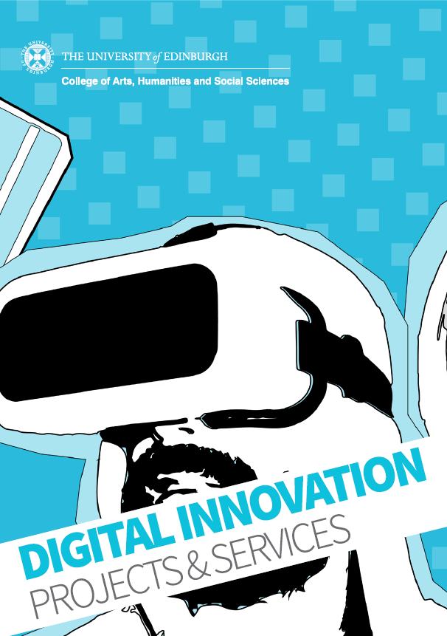
College Digital Innovation Team
Formed as the Web Team and renamed in 2017 to more clearly articulate the breadth of services offered
Team of digital developers, designers, copywriters and multimedia specialists who provide a digital development service to the schools within the College of Arts, Humanities and Social Sciences
Support digital development and innovation across all disciplines in the College

Slide 5
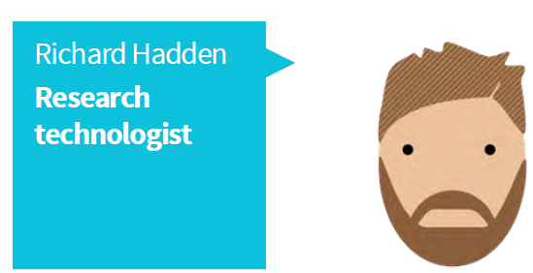
At College level
Research technologist in the Digital Innovation Team
Supports all Schools in the College
Works to common College standards and Strategy
high-level support, guidance and advice
use digital techniques for data gathering, analysis or dissemination
Innovate technical solutions and rapid prototypes
Establish a common definition & build a community of practice – work in progress
College open research strategy
Edinburgh Futures Institute

Slide 6
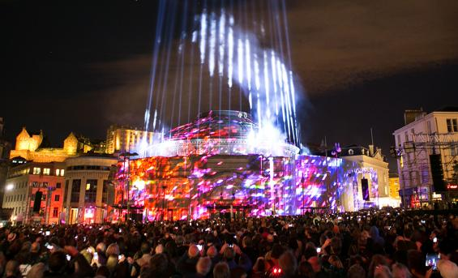
At School level
Each School has a general technology support team
Subsidiarity ➔ complement not duplicate central services
Specialist and discipline specific
Embed the research technologist/research software engineer/research developer in that professional team
Not reporting to the PI
Even if they are temporary
Following same common College technology standards
Provide continuity and a degree of resilience
Temporary > permanent if sufficient planned income stream

